Slide 1
Final Project Overview
Dr. Elaine McLemore

Slide 2
Visual Project
There is one final project for this course, a photography show that includes:
  a “curatorial statement” (250 words)
  10 captioned PowerPoint images (two to three sentences)
The final project is due as a hard copy in your last section meeting.
  Projects must be turned in on the date due to receive credit. Late projects and rewrites will only be accepted by prior arrangement.

Slide 3
Curatorial Statement
Curatorial statements are to be double spaced, using Times New Roman 12-point font.
For more information and additional examples of curatorial statements see the “resources” folder.

Slide 4
Curatorial Statement Instructions from the RISD Writing Center Guidelines
(full document with examples available in the “resources folder”
Curatorial Statement Guidelines
Your curatorial statement is a great opportunity to help guide the way the public perceives your exhibition. It’s a chance to communicate directly with viewers, help them understand your point of view, and get them excited and curious about the work they’re about to experience.
When writing the curatorial statement, it’s good to keep some general guidelines in mind. The statement should be about 200-300 words and 2-3 paragraphs. It can be helpful to follow a basic structure—for example, using the first paragraph to establish the overall premise of the exhibit, the second to illustrate the range of artists’ approaches with examples, and the third to suggest the wider significance of your theme. If there’s a particular work that was especially instrumental in the way you thought about the exhibition, it might be interesting to describe that work in depth to draw the viewer into your thought process. Some Gelman curators also write a supplementary handout that describes each work in the show in some detail. (See the Unnatural Science example on the back of this sheet.)
You should also think about the style of the statement. There are two audiences for your exhibition: the RISD community and the wider public. You want to be specific enough when articulating your agenda to engage the RISD community, but avoid using the kind of art-world jargon that might alienate a general audience. For instance, if there is a specific term that’s essential to the theme of the exhibition, make sure to define it in your curatorial statement. There is a great example of this in the “Synthetics” statement from the Whitney Museum below. “Synthetic” is clearly defined—as it pertains both to the physical properties of paint and to artificiality as a cultural ideal. As is the case in this example, a thoughtful consideration of your audience can often help you articulate your ideas more clearly.
In general, you want an informative and persuasive tone, somewhere in between an academic paper and a newspaper article. That means no use of the word “I” or first-person observations. The samples below should help you get a feel for the appropriate tone. Of course, the best way to find out how to express your thoughts is to get started writing your statement. We look forward to reviewing it with you.—Elizabeth Rossiter, Writing Center tutor, 2010

Slide 5
Curatorial Statement Questions
    Is the statement the correct length, about 250 words?
    Does the first section establish the overall premise of the exhibit?
    Does the second section illustrate the range of artists’ approaches, use of photographs, and display space with examples?
    Does the third section suggest the wider significance of the theme?
    Is the tone informative and persuasive (somewhere in between an academic paper and a newspaper article)?

Slide 6
A Strange and Fearful Interest: Death, Mourning, and Memory in the American Civil War
Huntington Museum (https://www.huntington.org/strange-and-fearful-interest)
The American Civil War claimed the lives of 750,000 Americans. Death and mourning defined the four wrenching years between 1861 and 1865, leaving an indelible imprint on the nation at large. During these years, photography became a powerful tool of reportage and remembrance: "the field of photography is extending itself to embrace subjects of strange and sometimes of fearful interest," wrote Oliver Wendell Holmes in reference to a haunting series of Civil War views. Drawing on more than 200 works from the superb Civil War collections at the Huntington Library, many never published before, A Strange and Fearful Interest explores how photography and other media were used to describe, explain and perhaps come to terms with a national trauma on an unprecedented scale. The volume focuses on the Battle of Antietam (not only the bloodiest day in the nation's history, but also the first in which photographs of American battlefield dead were made); the assassination of Abraham Lincoln, the national mourning that ensued and the execution of the conspirators; and the establishment of Gettysburg National Monument as part of larger attempts at reconciliation and healing.

Slide 7
ICONS OF STYLE: A CENTURY OF FASHION PHOTOGRAPHY, 1911-2011
Getty Museum (https://www.getty.edu/art/exhibitions/fashion_photography/)
Why do some fashion photographs transcend their commercial character to function as works of art, while others do not? In part, the answer lies in the ability of a fashion photograph to reflect two or more worlds: the perfect world inside the frame—where youth, beauty, and luxury reign supreme—and the harsh realities of the world outside it. The best fashion photographs remind us of other works of art or expand the boundaries of the genre, redefining what a fashion photograph is supposed to do, or be.
Beginning with 1911—the year Edward Steichen created the first “artistic” fashion photographs—and ending with 2011 with digital technology as a dominant paradigm, this exhibition surveys the rich and varied history of modern fashion photography. The show traces its trajectory from niche industry to powerful cultural force, and its gradual embrace as an art form.

Slide 8
Projected Meanings: The American Flag in Documentary Photography, 1940 - Present (Peer Example, used with permission)
The symbolism of the American flag is widespread and traditionally recognized as a sign of freedom, liberty, and American democracy; however, as time progresses, the American flag has been used in ways that support and complicate that seemingly straightforward narrative. American flags are a common occurrence in photographs of life in the United States, and through these photographs, a more complex understanding of this symbol comes to light. Albert Boime for the Smithsonian Studies in American Art states, “The ability of human beings to endow material objects with meaning is especially seen in the signifying functions of flag.”(1) The flag is used as a tool of celebration, mourning, motivation, an assertion of power, a call for change and more. Photographs give examples of how the flag’s meaning is being projected to the public, which offers viewers an understanding of the use of the flag at that moment in time.
This collection of photographs displays how the American flag has projected a variety of meanings since the late WWII era to the present. Dorothea Lange, Robert Frank, Burk Uzzle, and even Neil Armstrong, present an aspect or belief of American life that has been mirrored onto the flag. The combination of images from these photographers, shows how pliable the interpretations of the American flag has been throughout American history.

Slide 9
Captions
You will caption and contextualize the selected images (2 to 3 sentences per image).
Images must be placed within a historic, thematic, and/or theoretical framework (similar to the Image ID section in exams).
For more information on writing label see the Museum of Modern Art PowerPoint presentation “Writing Effective Art Labels: A Nuts and Bolts Primer.”
  (link here https://www.slideshare.net/stephaniepau/writing-effective-interpretive-labels-for-art-exhibitions-a-nuts-and-bolts-primer)

Slide 10
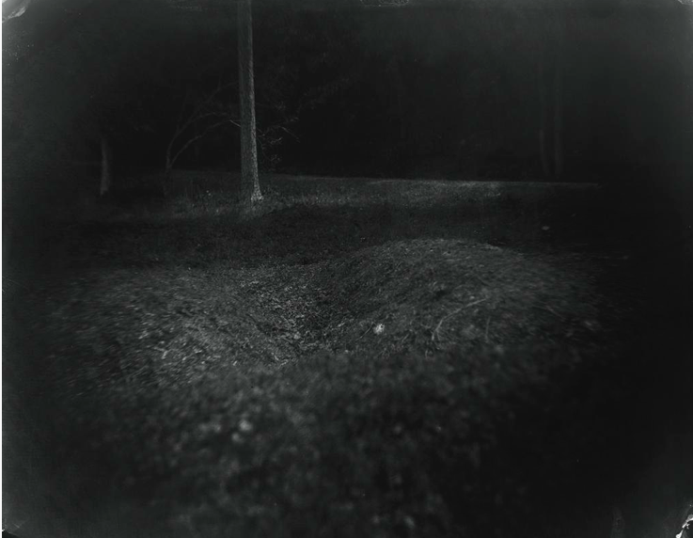
Captions
Similar to Image ID section of the exams
Visual details of the image. What do you see in the slide? Pay particular attention to the visual space and layout.
Location
Contextualize the image
Sally Mann: A Thousand Crossings
GETTY CENTER
Daily, through February 10, 2019
Wall Label (caption example)
The Battle of Antietam, fought near Sharpsburg,
Maryland, on September 17, 1862, was the bloodiest
single day of the American Civil War, with more than
twenty-three thousand Confederate and Union casualties.
One Union surgeon reported that most of the dead
remained unburied more than a week later.
By positioning her camera close to the ground for a
number of these photographs, Mann assumed the
viewpoint of a dying soldier. She used antique lenses,
welcoming the light leaks, fogging, and flares they Sally Mann, Antietam, 2001.
produced to convey the unsettling history of the landscapes.

Slide 11
Sources
You must use the course material and two additional sources to contextualize your subject in your curatorial statement. Sources published online must be peer reviewed and published in an academic journal (see resources folder for more information). No sources with unknown authors will be accepted.
All outside information and ideas must be cited. I prefer the Chicago Manual of Style (CMS) but APA and MLA will also be accepted. For information on citing using the CMS see: http://www.chicagomanualofstyle.org/tools_citationguide.html.
Additionally, please use only high-resolution images in your project. To find high quality images I recommend using the large digitized photography collections with titling information available through the Getty Museum and Museum of Modern Art (MoMA) websites and the ArtStor database (available through the library website). An overview of how to search for photographs on ArtStor is available in the course “resources folder.”
UC Santa Barbara’s Writing Lab offers students free consultations at any stage of the writing process. Consultants are available online by appointment.

Slide 12
Additional Resources
Grading rubric and examples (resources folder)

Slide 13
Optional 3% Extra Credit
Artsteps (www.artsteps.com)
  Complete instructions in the resources folder

Slide 14
I am happy to discuss your project at any stage or to review a draft with you during office hours or after class by appointment.
Notes:
Tech reminder

